Slide 1
بسم الله الرحمن الرحيم
قالوا سبحانك لا علم لنا
إلا ما علمتنا
إنك أنت العليم الحكيم
صدق الله العظيم
سورة البقرة الآية 32

Slide 2
Presentation rules

Slide 3
Terminology
Prepared by:
Dr :Mona Al –Deeb
Clinical demonistrator in gynecological and obstetric nursing

Slide 4
obstetrics
The branch of medicine concerned with pregnancy and childbirth, including the study of the physiologic and pathologic function of the female reproductive tract and the care of the mother and fetus throughout pregnancy, childbirth, and the immediate postpartum period.

Slide 5
Gynecology
The branch of medicine which treats female genital tract diseases
Ante – natal
The period Before birth

Slide 6
Uterus
The uterus is a flattened, hallow macular thick-walled organ, which looks like an upside – down pear
Fundus
The base or fundus uterus the top of the uterus

Slide 7
Cervix
The neck of the uterus. A constricted portion or neck. It is about 2.5cm Long and opens into the vagina. It has an internal os and External os. The internal os communicated with the body of the uterus and the external os opens into the vagina

Slide 8
Wharton's jelly
connective tissue of the umbilical cord
Vernix caseosa
The greasy substance which covers the fetus in utero.
Umbilical cord
The cord which connects the fetus and the placenta. It is about (50-60)cm in length. It consists of two arteries and one vein.

Slide 9
Show
It is denote the blood – stained discharge. At the onset of labor which comes from the cervical canal plug.
Striaegraviderum
The marks due to skin stretching, which are seen on the abdomen and to some extent on the breasts and thighs during and after pregnancy

Slide 10
Puerperium
The period following childbirth during which the uterus and other organs and structures are returning to the pre gravid state (A period of 6-8week after delivery. )
Menarche
The first sign of menstruation

Slide 11
Attitude
The relation of the fetal parts(head, spine and limbs to each other.
Lie
The relationship between long axis of the fetus to the long axis of the mother. Normally and most common lie is said to be longitudinal

Slide 12
Position
The relationship between the back of the fetus and the anterior abdominal wall of the mother . It may be RT.O.A or LT.O.A or LT.O.P & RT.O.P
Presentation
it is the first part from the fetus felt by the examinar

Slide 13
Placenta
A flat organ measuring 17.5-20 cm in diameter and 2.5 cm in thickness . It weighs approximately one- sixth of the baby's birth weight at full term. It is formed by the 12th week of pregnancy. Its functions to transmit oxygen and nutrients from the maternal blood to the fetus and to excrete carbon dioxide and other waste products of metabolism from the fetus to the mother. It also acts as a barrier to some infections

Slide 14
Placenta previa
An abnormally situated placenta in the lower segment of the uterus , either completely or partially covering the internal os
Abruption placenta
It is the premature separation of the placenta from a normally implanted site “the upper uterine segment”. It occurs after the 24th week of pregnancy. It may occur partially or completely. It also called “placental Abruption”

Slide 15
Ovulation
The process of liberating an ovum from the ovary by rupture of grafian follicles , it occurs at intervals of about 28 days and alternates between the 2 ovaries usually only one ovum is produced
Menopause
The normal cessation of menstruation

Slide 16
Ectopic pregnancy
The embedding of a fertilized ovum, usually in the fallopian tube, but occasionally in the ovary or abdominal cavity. Such pregnancy is un likely to continue for more than 6 or 7 weeks, and there is a considerable risk of hemorrhage
Parity
The condition of a woman with respect to have born viable infants

Slide 17
Multipara
A woman who has born more than one viable infant.
Grand multipara
The woman who has born 4 or more children.
Gravida
A pregnant woman .
Primi gravida
is the pregnant woman who is in the first pregnancy.

Slide 18
Multigravida
is the pregnant woman who has more than one pregnancy
Grand multigravida
The pregnant woman of high parity.
Lochia
The discharge from the uterus following childbirth, or abortion

Slide 19
Amenorrhea
Absence of menstruation. Amenorrhea is physiological during pregnancy and lactation, and after menopause
Amniotic fluid
The fluid contained in the amniotic sac , also called Liquor amnii and “waters” this fluid surround the fetus to help the his movement. The amount varies from 500 to1500 ml at term . Amniotic fluid is normally clear and strow colored , and is composed of 99% water and 1% solids, which include protein , carbohydrate, lipids and phospholipids ,electrolytes, urea , uric acid and creatinine ,pigments, enzymes and placental hormones

Slide 20
Poly hydraminios
Excessive amount of amniotic fluid.
Oligo hydraminios
An small amount of amniotic fluid.
Apgar score
It is a scoring system devised to assess the condition of baby during the first few minutes of birth. It based on five criteria : Heart rate , respiration ,muscle tone reflexes ,and color . Each item is rated from (0 to2) , the highest possible score is 10 and each of the factors is rated at (1 to5) after birth.

Slide 21
Cleft Lip
It is a congenital defect resulting from the failure of fusion . It is usually repaired during the first few weeks of life . It may be unilateral or bilateral.
Cleft Palate
It is a congenital defect which is often associated with cleft lip .It may be on one side of the palate or may be central. It interferes with the child's ability to suck and later with speech

Slide 22
Engagement
The entry of the presenting part of the fetus , generally the head in to the true pelvis.
Involution
Returning to normal size after enlargement e.g the uterus after labor

Slide 23
Sub involution
Incomplete or delayed return of the uterus to its pre- gravida size during pureperium. Usually due to retained produacts of conception and infection
Hyper involution
It is the process by which the general organs return back to normal within short time.

Slide 24
Caput succedaneum
It is an edematous swelling formed on the presenting part of the fetus :head”. It is present before delivery and disappear within a few hours. It can be pitted on pressure, and can cross the suture line on the scalp.
Cephalo hematoma
An effusion of blood beneath the periosteum of one of the cranial bones . It causes a swelling which develops on the head of the new born . It takes several weeks to subside.

Slide 25
Linea nigra
The pigmented line which often appears , during pregnancy on the abdomen between the umbilicus and pubis.
Meconium
The material present in the fetal intestinal tract, which is passed per rectum during the first few days of life. It is greenish black in color and contains bile pigments

Slide 26
Polarity
It is the neuromuscular harmony between the upper and the lower uterine segment to help dilatation of the cervix.
Bregma
The anterior fontanels, a kite – shaped membranous area in the head of the fetus and infant. At the junction of the frontal, coronal and sagittal sutures.

Slide 27
Breech
The buttocks.
B.B.T ( Basal Body Temperature)
It is the basal temperature recorded by the women every morning before getting up. It is done to determine the time of ovulation and avoid intercourse in this time of high temperature. It is one of contraceptive methods.

Slide 28
Ergot
A drug causes uterine contraction.
Hysterectomy
Removal of the uterus, may be abdominal or vaginal.
Inertia
In ability of the uterine muscle to contract efficiently. It is common cause of prolongation of labor.
Lightening
A subjective sensation reported by many women late in pregnancy as the fetus settles lower in the pelvis, leaving more space in the upper abdomen.

Slide 29
Fimbria
A finger – like extremity of the fallopian tube is described as fimbriated
Cilia
fine hair – like processes which grow on the free border of certain epithelial cells .The lining of the fallopian tubes is ciliated epithelium, the cilia make waves which carries the ovum from the ovarian end of the fallopian tube to the uterus . Single one called – cilium. Ciliated-- having cilia

Slide 30
Perineal
Pertaining to the perineum.
Deciduas
The names give to the endometrium of the uterus during pregnancy. It is shed when pregnancy terminated. It is of types: Deciduas basalis, capsularis and Vera.
Clitoris
It is the small sensitive organ of the female external genitalia. Consisting of erectile tissue, situated at the anterior junction of the labia minora. It is the homologue of the male penis.

Slide 31
Bartholin’s glands
Two glands situated in the labia majora, with ducts opening in the vagina, just external to the hymen, they produce the secretion which lubricates the vulva.
Cervicitis
It is an infection of the mucous membrane lining the cervix .It is acute or chronic. The inflamed mucous membrane through the external os to the vaginal parts of the cervix. Treatment can be by destruction of the infected tissue by cauterization

Slide 32
Fibroids
are muscular tumors that grow in the wall of the (womb). Another medical term for fibroids is "leiomyoma" or just "myoma".
Conception
It is the fusion of sperm and ovum to form a viable zygote at the onset of pregnancy.
Implantation
The act of planting or setting in of the fertilized ovum in the enodmetrium

Slide 33
Fertilization
The union of the spermatozoon and the ovum. Also called conception.
Nipple
The small conical projection in the center of the Areola of the breast which gives out let to the milk from the breast .

Slide 34
Areola
It is the pigmented area which surrounds the nipple. It darkens during pregnancy and is termed the primary areola, with a secondary areola developing later around its

Slide 35
Engorgement of the breasts
Painful accumulation of secretion in the breasts, often accompanied by lymphatic and venous stasis and edema at the onset of lactation. If breast feeding, the milk may need to be expressed, either manually or by machine, until the areola is softer and the baby may fix correctly onto it.

Slide 36
Mastitis
Inflammation of the breast
Pregnancy
The condition of having a developing embryo or fetus within the body, the state from conception to delivery of the fetus. The normal duration about 280 days / 40 weeks/9 months counted from the first day of the L.M.P
LMP
Last menstrual period date

Slide 37
EDD
Expected date of deliveray. It is calculated by counting for words 9 months and adding 7 days from the first day of the last menstrual period, or counting back 3 months and adding 7 days.

Slide 38
Cholasma
The pregnancy mask, or pigmentation of the skin of the fore head, nose and cheeks, seen quite commonly in pregnancy

Slide 39
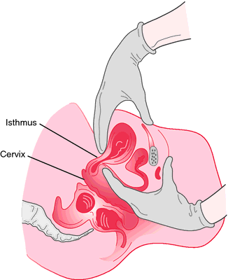
Hagar's sign
A test of pregnancy, not usually as it is uncomfortable for the woman. It can be done between the 6th and 10th weeks of gestation when the embryo only occupies the upper part of the uterus. The lower pint above the cervix is greatly softened and on bimanual examination almost allows the fingers to meet.

Slide 40
Labor
The physiological process by which the fetus is expelled from the uterus at term with normal appearance about 280 day after last menstrual date. It takes 4 stages

Slide 41
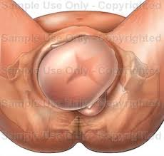
Crowning
The moment during birth when the suboccipito bregmatic and biparietal diameters of the fetal head are distending the vulval ring and the head no longer recedes between contractions

Slide 42
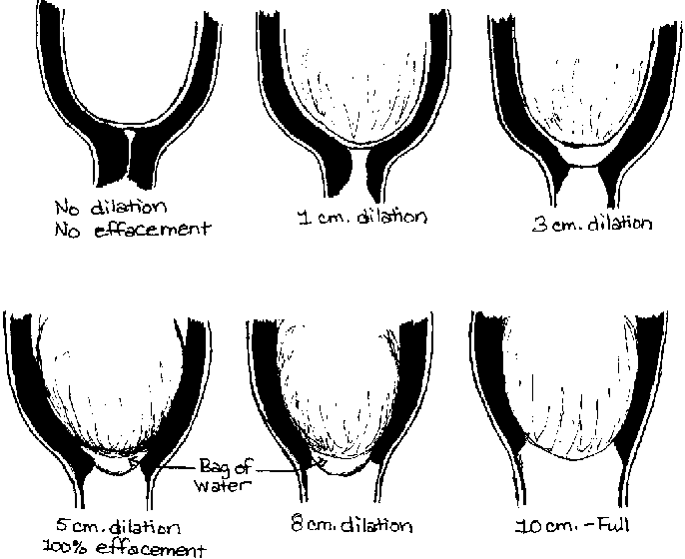
Dilatation
Stretching of either an orifice of an organ. It may be natural as in the cervix during the first stage of labor, or artificial as in the curettage of the uterine cavity

Slide 43
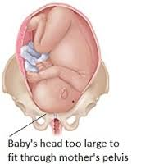
Delivery
Natural expulsion or extraction of the Infant, placenta and fetal membranes at birth.
Disproportion
Lack of harmony, or lock of a proper relationship between one object and another. In obstetrics, this is refers to disparity between the fetal head and the pelvis of the mother through which it is to pass.

Slide 44
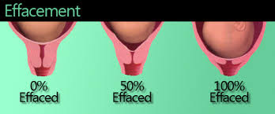
Effacement
"Taking up" of the cervix. The process by which the internal os dilates, so opening out the cervical canal. This process Precedes cervical dilatation in the primigravida. Which both occur simultaneously in a multigravida during labor.

Slide 45
Contraction
A temporary shortening of the muscle fibered, which returns to its original length during relaxation. During labor they may and generally become painful and are accompanied by retraction.

Slide 46
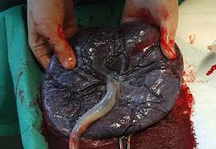
Placenta
A flat organ measuring 17.5-20 cm in diameter and 2.5 cm in thickness. It weighs approximately one – sixth of the baby's birth weight at full term. It is formed by the 12th week of pregnancy. Its functions to transmit oxygen and nutrients from the maternal blood to the fetus and to excrete carbon dioxide and other waste products of metabolism from the fetus to the mother. It also acts as a barrier to some infections

Slide 47
Braxton Hicks Contractions
Painless, irregular uterine contractions occurring during pregnancy, as the pregnancy advances; they gradually increase in intensity and frequency and become more rhythmic during the third trimester. They are often mistaken for true labour pain and some – times referred to as "False labor“
Atony
Lack of muscle tone

Slide 48
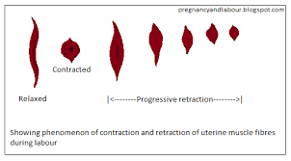
Quickening
The first perceptible fetal movement, felt by the mother at approximately the 18th to 20th week in primi gravida and recognized at 16th week in multigravida.
Retraction
The process of permanent and progressive shortening of muscle of the uterus which a accompanies contraction during labor

Slide 49
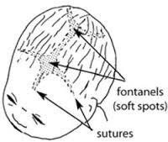
Moulding
The process of overriding of the cranial bones at the sutures and fontanels where by the fetus adapts itself to the pelvis through which it is passing
Osiander,s sign
Pulsation of the uterine arteries through the lateral fornices which can be detected on examination per vagina in early pregnancy

Slide 50
Embryo
The embryo is usually so called for the first 8 weeks after conception, the term fetus used subsequently
Fetus
The human embryo from the 8th week of pregnancy to the time of birth. And the infant is being subsequently after 8th week of pregnancy

Slide 51
False Labor pain
uterine contraction giving rise to discomfort and stimulating labor, but not causing dilatation of the cervix.
Family Planning
The arrangement, spacing and limitation of the children on a family, depending upon the wishes and social circumstances of parents.

Slide 52
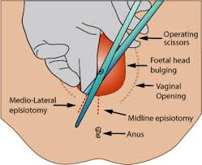
Episiotomy
An incision made in to the thinned-out perinea body to enlarge the vaginal orifices during delivery. The incision may be mediolateral or median.

Slide 53
Dyspareunia
Difficult or painful coitus.
Dysmenorrhea
Difficult or painful menstruation. It is characterized by cramp like pains in the lower abdomen, and sometimes by headache, irritability, mental depression, malaise and fatigue.

Slide 54
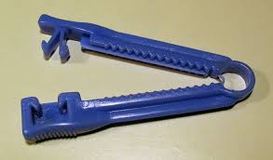
Clamp
A surgical instrument used to compress any part of the body. E.g. to prevent or arrest hemorrhage . In obstetric it is used to occlude the vessels of the umbilical cord, it is applied at birth.

Slide 55
Criminal abortion
This is an attempt to induce abortion with no medical indication or the intentional termination of pregnancy under any condition prohibited by low.
Coombs test
A test for detecting antibody in blood. Indirect C.T. to detect free antibody in maternal blood. Direct C.T. to detect antibody on red cell surfaces in the umbilical cord blood.

Slide 56
Hydrocephalus
is an abnormal expansion of cavities (ventricles) within the brain that is caused by the accumulation of cerebrospinal fluid. Hydrocephalus comes from two Greek words: hydros means water and cephalus means head. There are two main varieties of hydrocephalus: congenital and acquired. An obstruction of the cerebral aqueduct (aqueductal stenosis) is the most frequent cause of congenital hydrocephalus. Acquired hydrocephalus may result from spina bifida, intraventricular hemorrhage, meningitis, head trauma, tumors, and cysts.

